Slide 1

Robust Car Modification Simulation System using AI
Department of Computer Science
COMSATS University Islamabad, Abbottabad Campus
FATIMA AFTAB FA21-BSE-088
BASIT IQBAL FA21-BSE-050
SYED SHAH HUSSAIN BADSHAH FA21-BSE-172
DR AHMED SAEED KHATTAK

Slide 2
Agenda of the Presentation
Introduction
Scope
Functional Requirements
Non-Functional Requirements
DFD
Use cases
Summary of 60%
Gant Chart (Schedule)

Slide 3
Introduction
Web-based tool for modification centers
Realistic previews of vehicle customizations
AI-driven detection for accurate overlays
Enhances customer engagement and confidence

Slide 4
Scope (What to do)
A web-based application for car modification centers that offers high-quality, realistic previews.
Part detection and segmentation for accurate modification overlays on vehicle images.
A wide customization catalog including rims, spoilers, paint, headlights, and side mirror shells.
The ability for operators to upload or capture images of vehicles for customization.
Subscription-based access model for flexibility and scalability.
Focus on external modifications with realistic previews and save options.

Slide 5
Scope (What no to do)
No Real-Time Video Feed Modifications
Exclude Interior Modifications
No High-End Hardware Requirements
Avoid Standalone Installation
No Custom Modifications Outside Catalog
No Complex 3D Modeling

Slide 6
Functional Requirements
FR-001 - Admin Registration
FR-002 - Admin Login
FR-003 - Operator Registration (add operator by admin)
FR-004 - Operator Login
FR-005 - Login Credential Validation
FR-006 - Secure Credential Storage
FR-007 - Upload Image
FR-008 - Capture Image
FR-009 - Image Preview
FR-010 - AI-Driven Part Detection
FR-011 - Overlay Custom Parts
FR-012 - Car Parts Catalog (Inventory)
FR-013 - Manage Catalog
FR-014 - Save Customizations
FR-015 - Retrieve Saved Customizations (View samples)
FR-016 - User Account Management
FR-017 - API Integration for AI Models

Slide 7
Non-Functional Requirements
1. Usability
Easy Image Upload & Preview
User-Friendly Interface
2. Performance
Image Processing Speed
API Response Time
3. Scalability
Support for New Features and Modules
Horizontal Scaling with Minimal Downtime
4. Maintainability
Zero-Downtime Updates and Bug Fixes
Comprehensive Developer Documentation
Modular and Replaceable Components

Slide 8
Continue
5. Accuracy
High Accuracy in Part Detection and Segmentation
Regular Testing and Validation
6. Modularity
Modular Architecture Design
Well-Defined Interfaces for Integration
Easy Addition of New Features
Independent Module Testing
7. Flexibility
Adding New Car Models and Parts
Extensible for Future Modifications
8. Effectiveness
Quick Customization Process
Realistic AI-Powered Previews

Slide 9
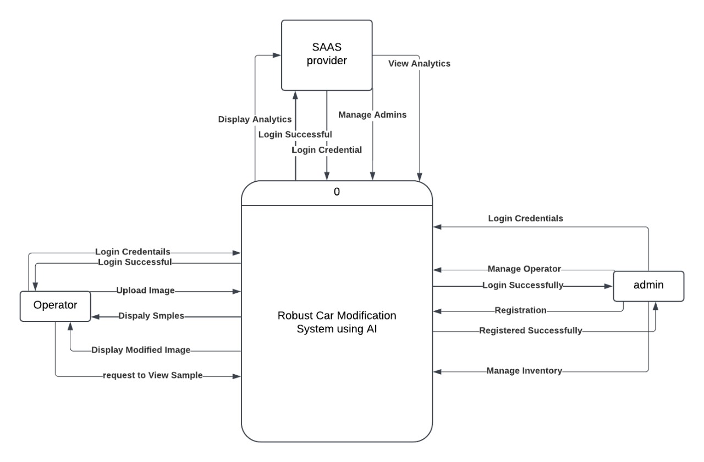
DFD Level 0

Slide 10
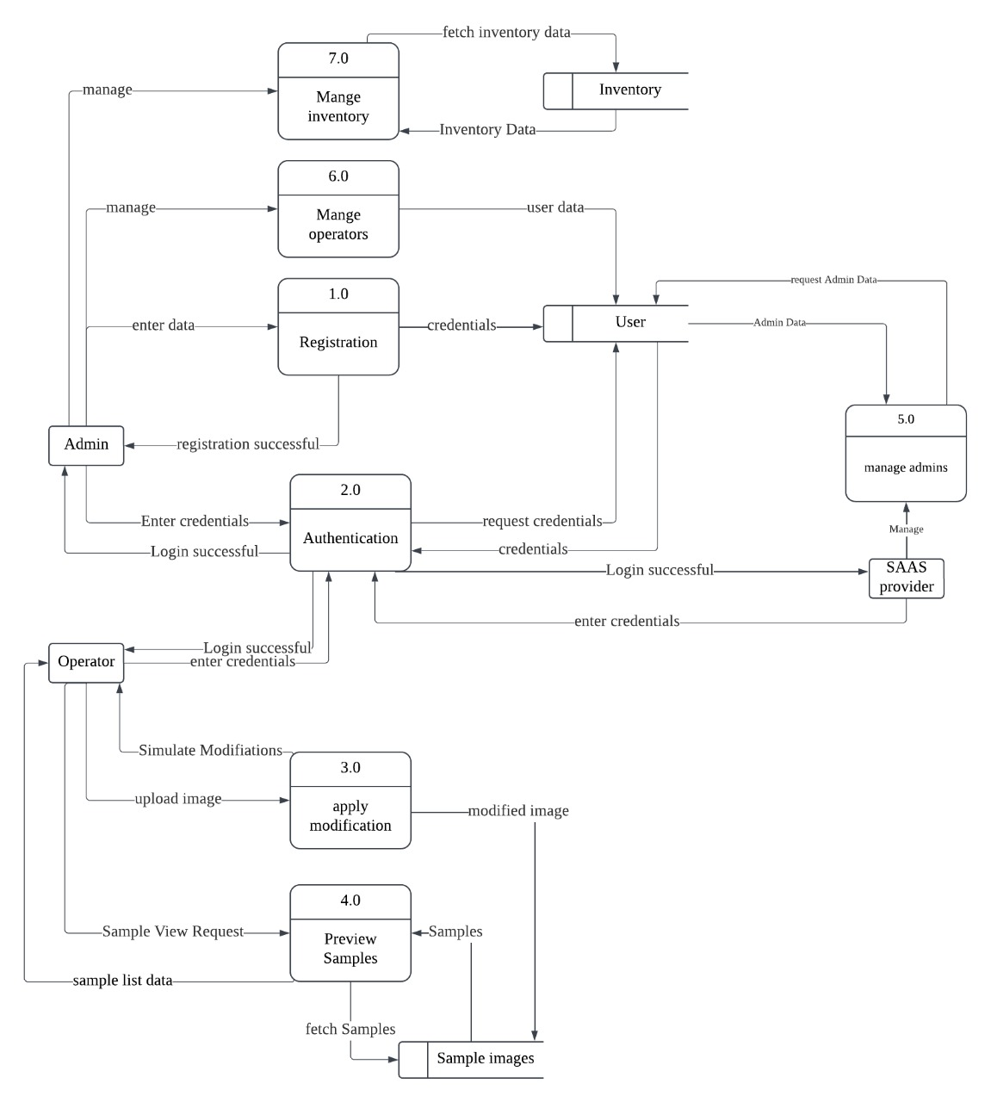
DFD Level 1

Slide 11
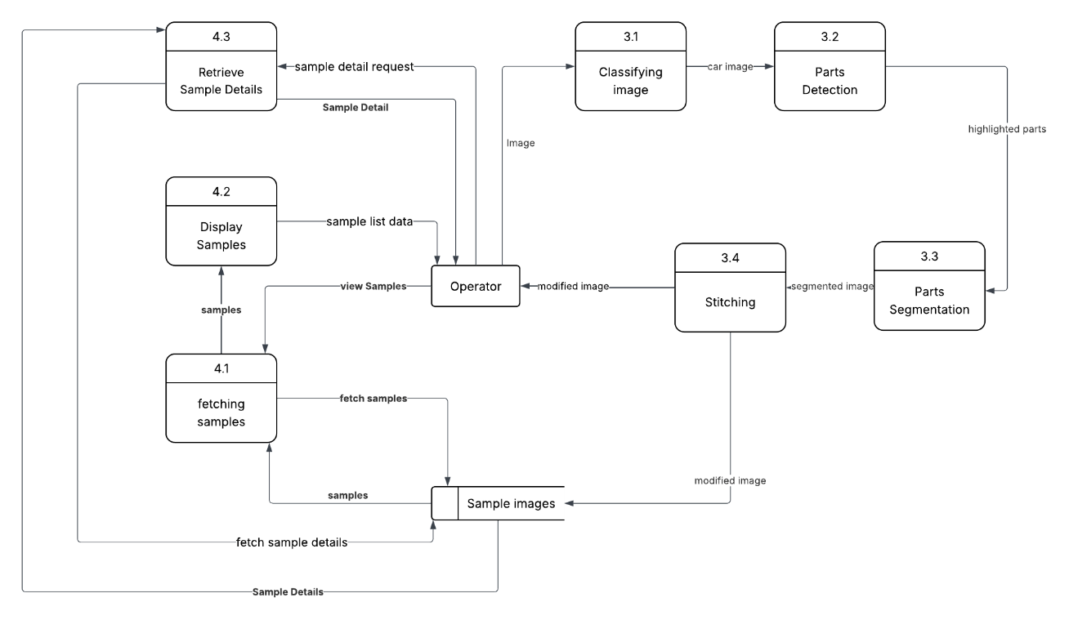
DFD Level 2 (process 3.0 &4.0)

Slide 12
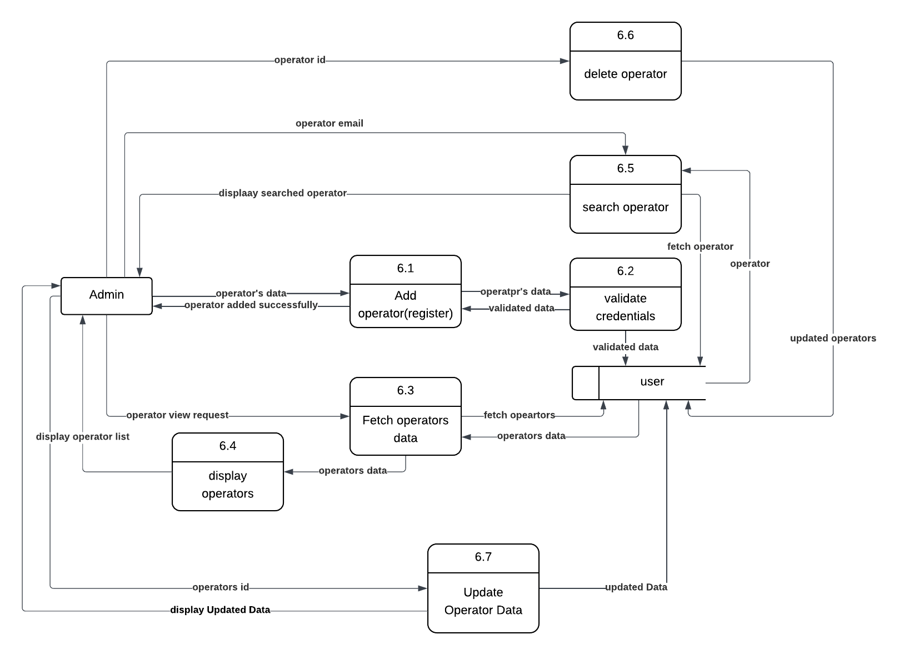
DFD Level 2 (process 6.0)

Slide 13
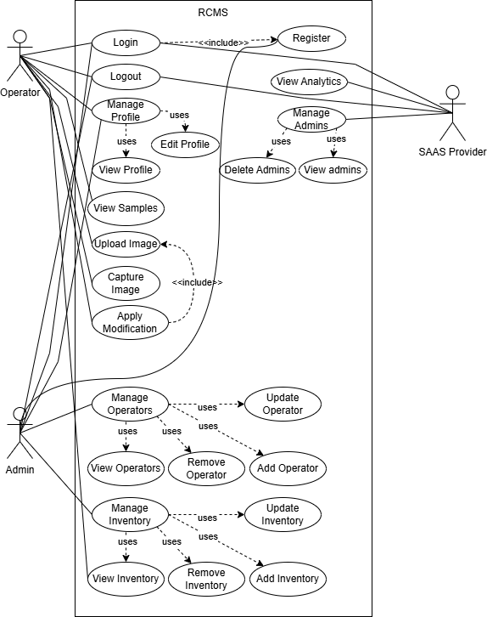
Use Case Diagram

Slide 14
Summary of 60% Project Implementation
Car parts detection using YOLOv8 Mode
Segmentation of car parts using SAM
Parts Extraction
Backend Setup
Backend with Frontend connectivity
Inventory Management

Slide 15
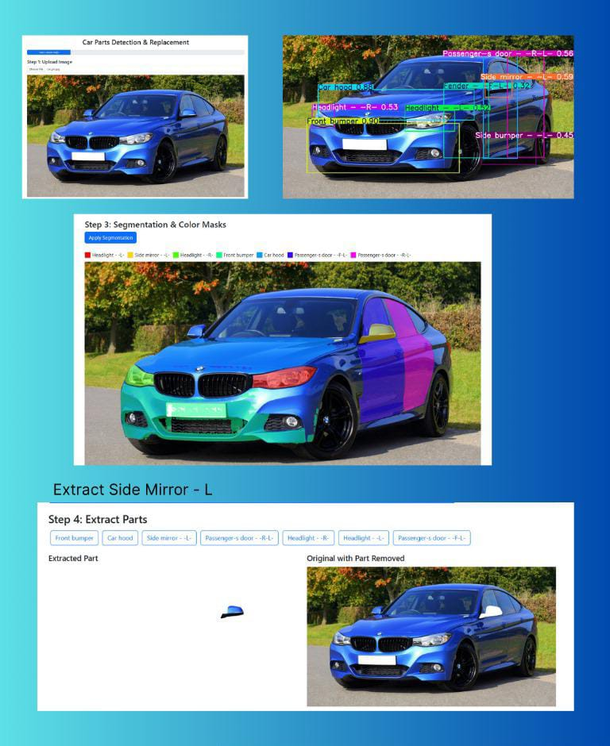

Slide 16
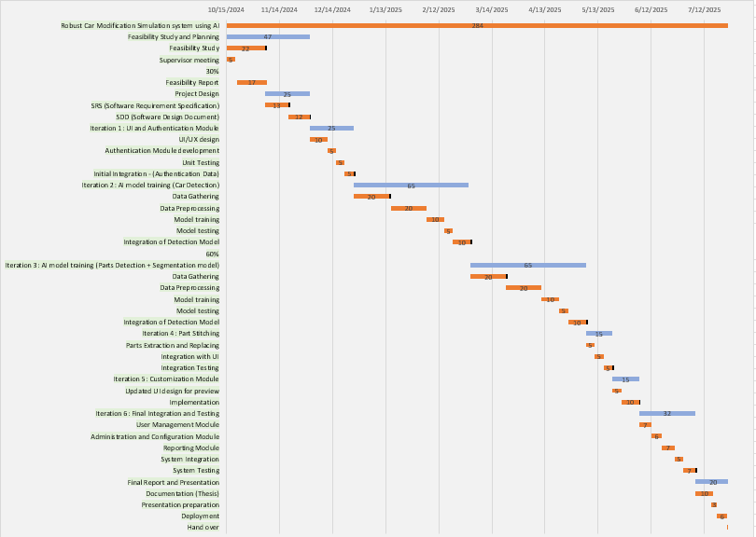
Gantt Chart

